Slide 1
Pin Diagram of 8086 Microprocessor

Slide 2
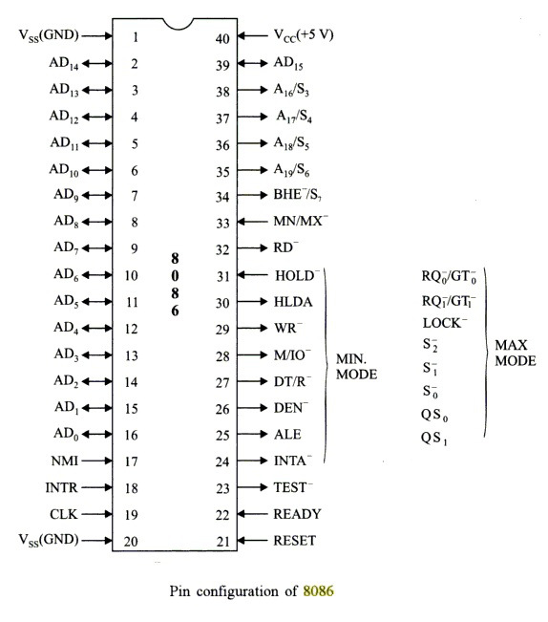

Slide 3
8086 is a 40 pin IC
[1] [20] Vss is ground
[40] Vcc is +5V power supply
[19] Clock → for timing purpose. Clock is generated externally. Works at 5MHz.
[39, 2 – 16] AD15 to AD0 → Address/data bus lines compose multiplexed address/data bus on the 8086. Contain address bits A15 – A0 when [25] ALE=1 and contain data D15 – D0 when ALE = 0
[35 – 38] A19 – A16/ S6 – S3 → Address/Status bus bits are multiplexed to provide address signals A19 – A16 and also status bits S6 – S3.
S6 → always 0 and S5 → Condition of IF flag bit
S4 | S3 | Function
0 | 0 | ES
0 | 1 | SS
1 | 0 | CS [or I/O port Access]
1 | 1 | DS

Slide 4
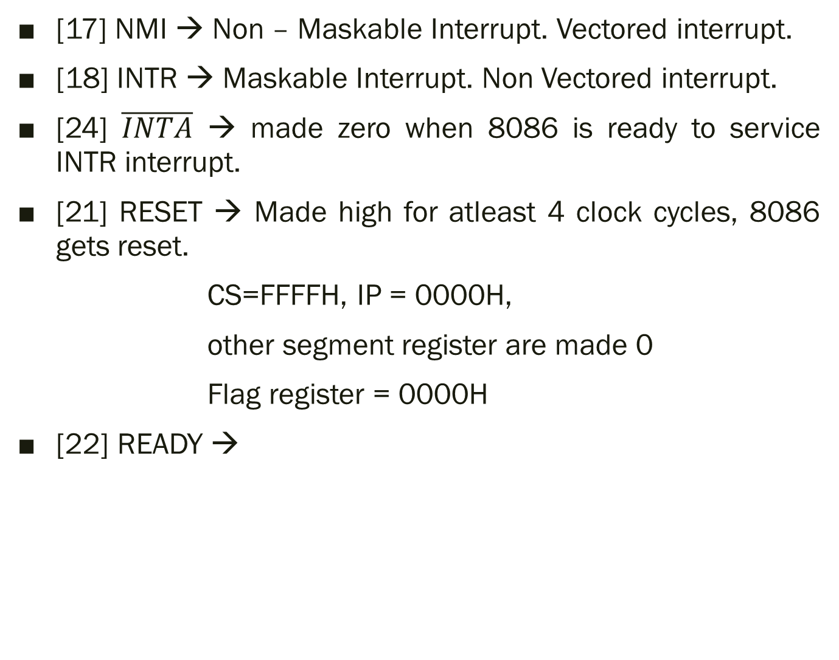
[17] NMI → Non – Maskable Interrupt. Vectored interrupt.
[18] INTR → Maskable Interrupt. Non Vectored interrupt.
[24] $\overline{INTA}$ → made zero when 8086 is ready to service INTR interrupt.
[21] RESET → Made high for atleast 4 clock cycles, 8086 gets reset.
CS=FFFFH, IP = 0000H,
other segment register are made 0
Flag register = 0000H
[22] READY →

Slide 5
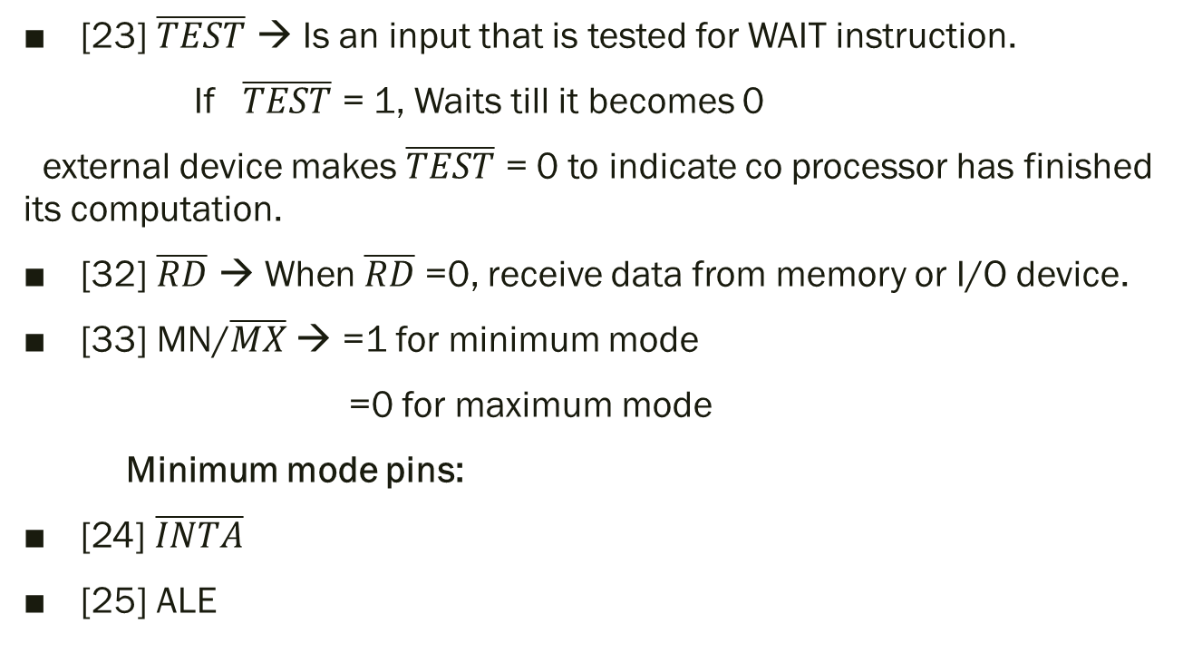
[23] $\overline{TEST}$ → Is an input that is tested for WAIT instruction.
If $\overline{TEST}$ = 1, Waits till it becomes 0
external device makes $\overline{TEST}$ = 0 to indicate co processor has finished its computation.
[32] $\overline{RD} \text{→ }\text{When} \overline{RD}$ =0, receive data from memory or I/O device.
[33] MN/$\overline{MX}$ → =1 for minimum mode
=0 for maximum mode
Minimum mode pins:
[24] $\overline{INTA}$
[25] ALE

Slide 6
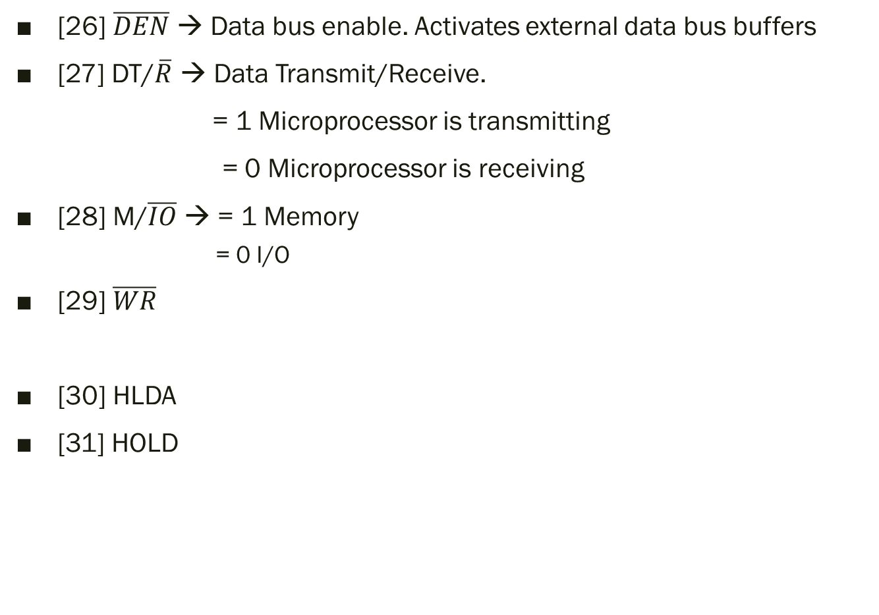
[26] $\overline{DEN}$ → Data bus enable. Activates external data bus buffers
[27] DT/$\overline{R}$ → Data Transmit/Receive.
= 1 Microprocessor is transmitting
= 0 Microprocessor is receiving
[28] M/$\overline{IO}$ → = 1 Memory
= 0 I/O
[29] $\overline{WR}$
[30] HLDA
[31] HOLD

Slide 7

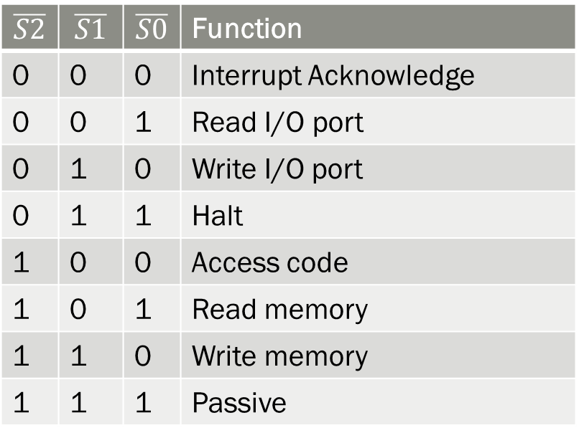
Maximum mode pins:
[28, 27, 26] $\overline{S2}$, $\overline{S1} and\overline{S0}$
[30, 31] $\overline{RQ0}$/ $\overline{GT0}$, $\overline{RQ1}$/ $\overline{GT1}$ → DMA during maximum mode operation.
[29] $\overline{LOCK}$ → lock peripherals off the system.
[24, 25] → Qs1 and Qs0 queue status
$$\overline{S2}$$ | $$\overline{S1}$$ | $$\overline{S0}$$ | Function
0 | 0 | 0 | Interrupt Acknowledge
0 | 0 | 1 | Read I/O port
0 | 1 | 0 | Write I/O port
0 | 1 | 1 | Halt
1 | 0 | 0 | Access code
1 | 0 | 1 | Read memory
1 | 1 | 0 | Write memory
1 | 1 | 1 | Passive

Slide 8
[24, 25] → Qs1 and Qs0 queue status
QS1 | QS0 | Function
0 | 0 | Queue is idle
0 | 1 | First byte of opcode
1 | 0 | Queue is empty
1 | 1 | Subsequent byte of opcode

Slide 9
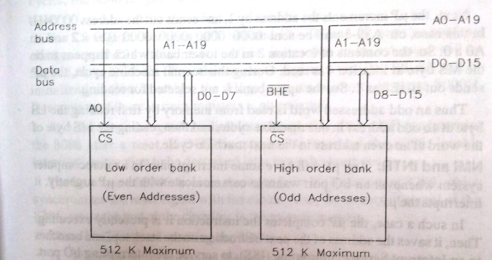

$\left[34\right] \overline{BHE}$/S7 →
At T1 clock cycle microprocessor sends $\overline{BHE}$. In subsequent clock cycles, Microprocessor sends 0 on S7 as status information.
Following cases of memory accesses are encountered:
1. Accessing an even addressed byte
2. Accessing an odd addressed byte
3. Accessing an even addressed word
4. Accessing an odd addressed word

Slide 10
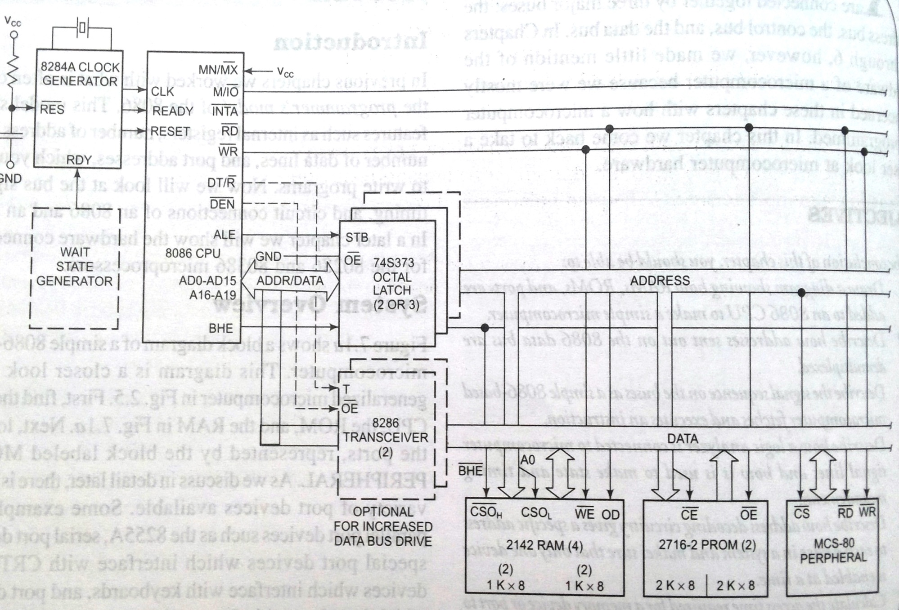
`

Slide 11
